Slide 1

Tutorial 5: Bayesian models
BAMB! Summer School Tutorial 5

Slide 2

Tutorial overview
Basic Bayes
Bayesian Observers
Bayesian Cognition
*Note: These sections are somewhat independent, you can skip to parts that interest you more if you are running low on time

Slide 3
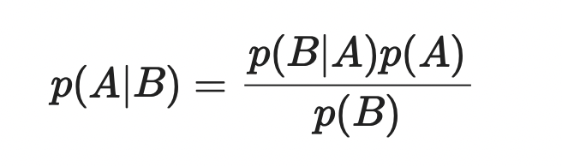
1. Basic Bayes
Simple statistics
Statistics over distributions
Using prior knowledge

Slide 4
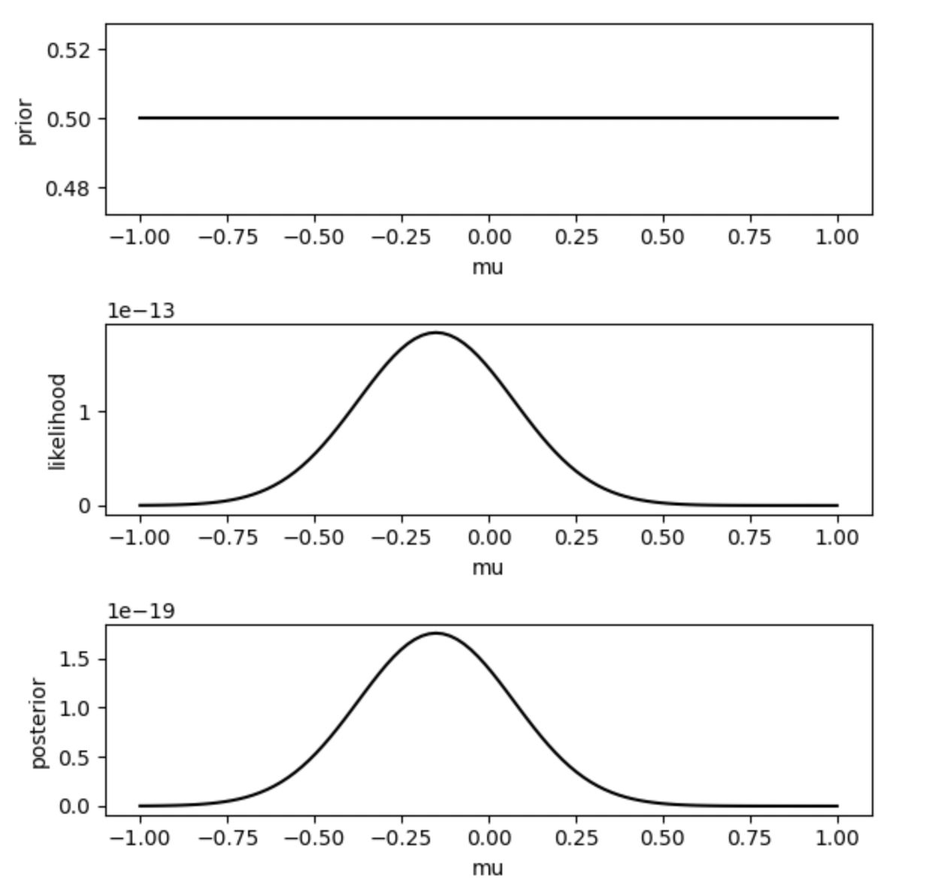
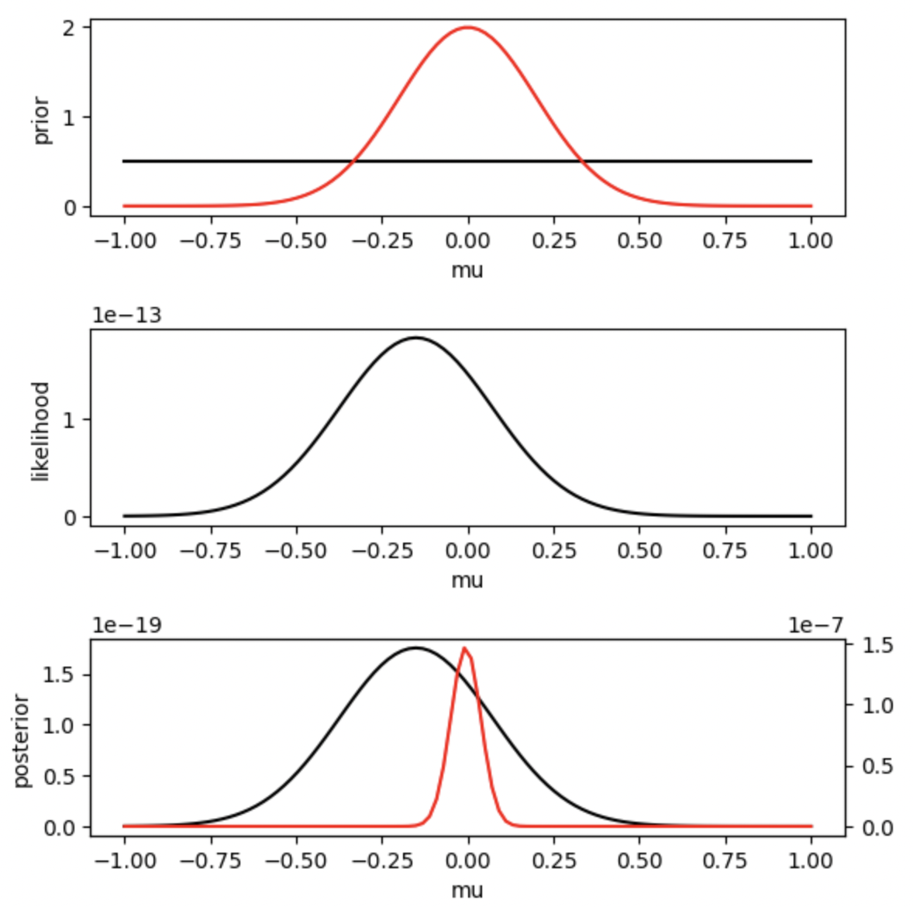
1. Basic Bayes

Slide 5
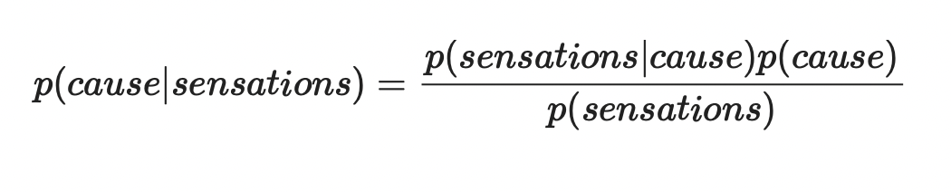
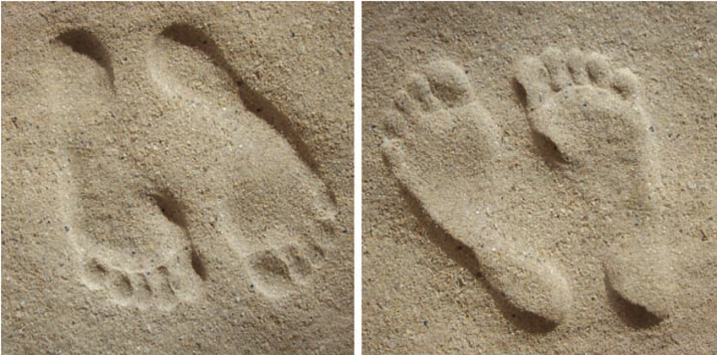
2. Bayesian Observers

Slide 6
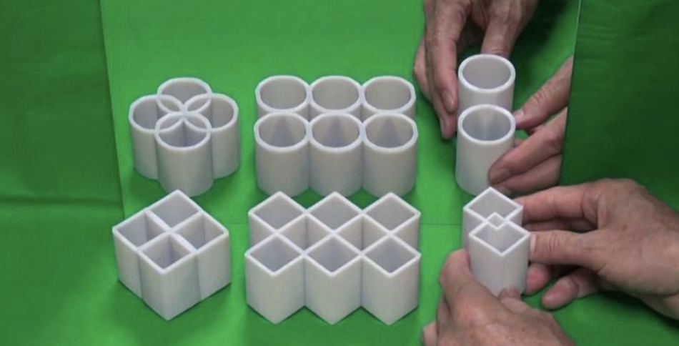
2. Bayesian Observers

Slide 7
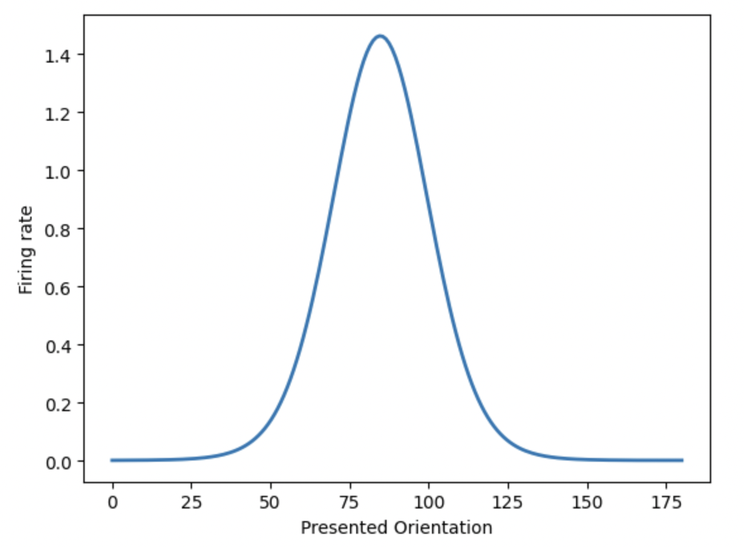
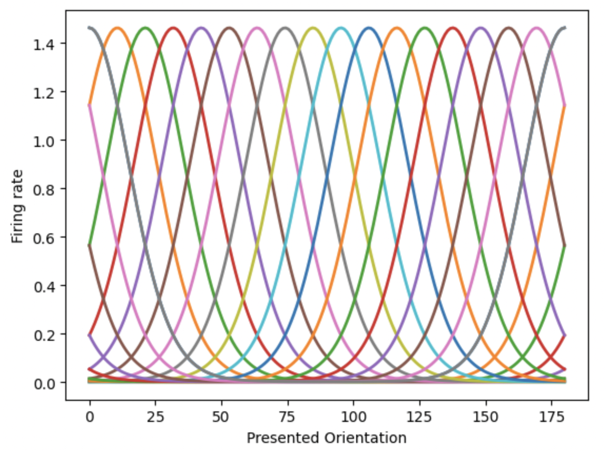
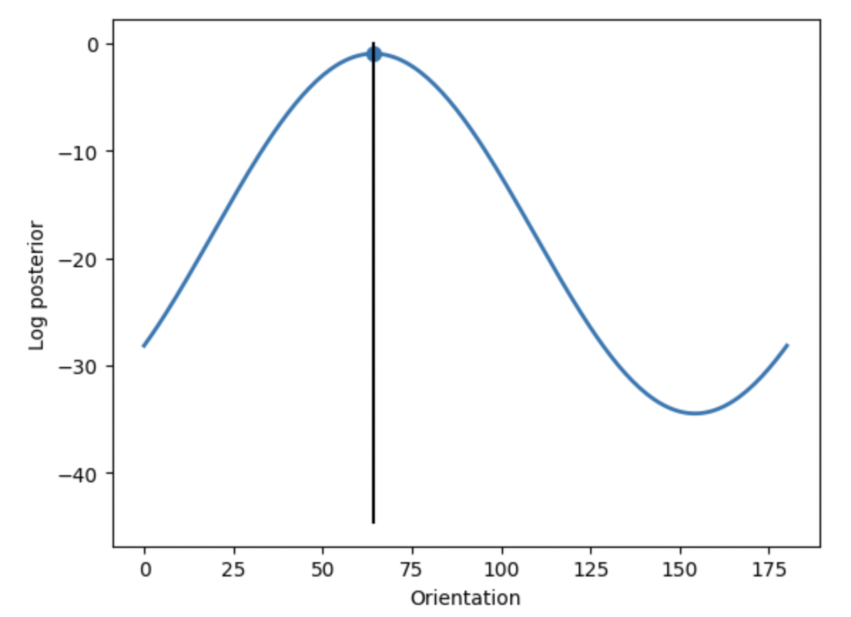
2. Bayesian Observers
Maximum a posteriori

Slide 8
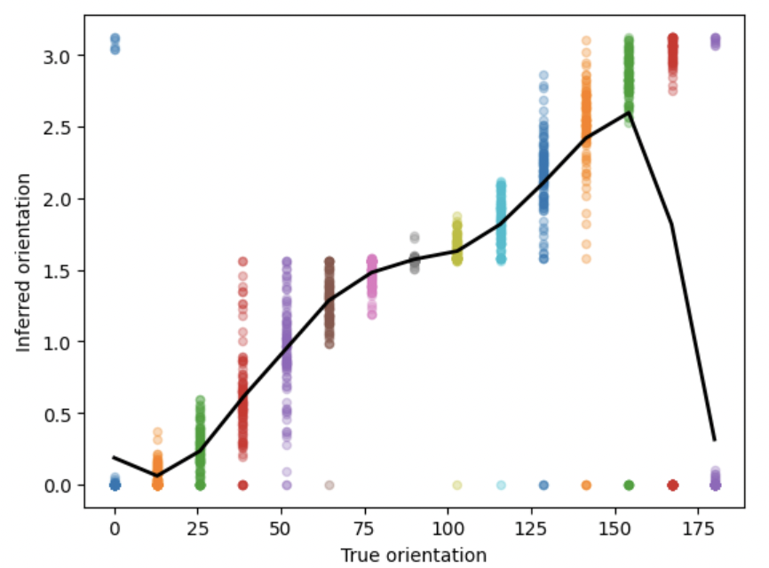
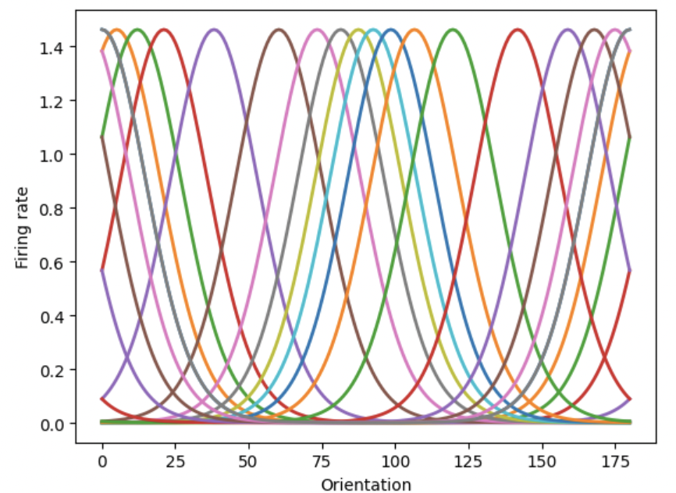
2. Bayesian Observers
* Only if you have time

Slide 9
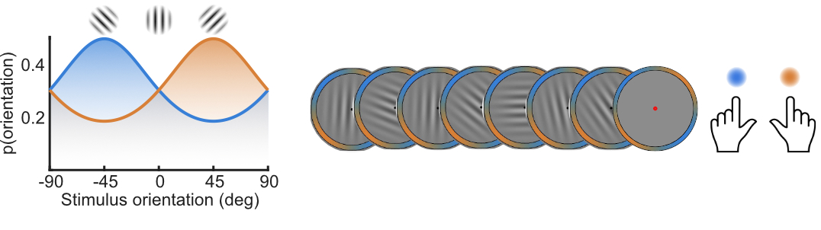
3. Bayesian Cognition
"today’s posterior is tomorrow’s prior”
(Lindley, Bayesian statistics, a review. 1972, p. 2)
Accumulating log-likelihoods is the optimal way to infer the cause of sequential samples of evidence
Balsdon, Mamassian & Wyart, 2021

Slide 10
Tutorial overview
Basic Bayes
Bayesian Observers
Bayesian Cognition
*Note: These sections are somewhat independent, you can skip to parts that interest you more if you are running low on time
Job Ad: 2 postdoc positions available with Marios Philiastides, Univ Glasgow
Funded for 3 years, play with cool tech (simultaneous EEG-fMRI) and models!
https://mphiliastides.org/en/ (closes 31 Aug. see me for details)

